Slide 1

Anomaly Detection
CSCE 665 Advanced Network and Security
Srishti Agarwal, Suma Garuda

Slide 2

Motivation
Increase in the number of attacks
Endpoints are mostly cloud based as to reduce cost of infrastructure and computing.

Slide 3
Endpoint Intrusion Detection

Slide 4



Our Approach
Real time Alerts
Logging
a
Analysis of results
Logging
Update

Slide 5

Snort Based HIDS
Open source tool for
Sniffing
Packet Logging
Intrusion Detection
Performs real time traffic analysis by comparing it against a rule set defined by the user. (byte sequences/flags etc.)
Depending on the action specified, packets will
Generate an alert on console
Be logged
Be dropped

Slide 6
Network Attacks

Slide 7
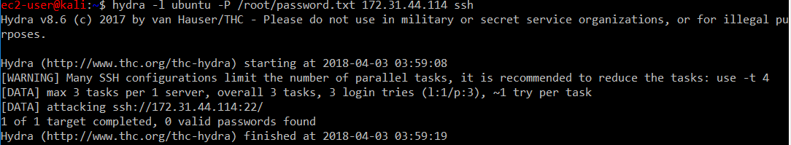
SSH attacks
An automated program often tests combinations (either dictionary based or brute force) of possible usernames and passphrases to break the SSH authentication mechanism.
Tool used to launch attack: Hydra

Slide 8
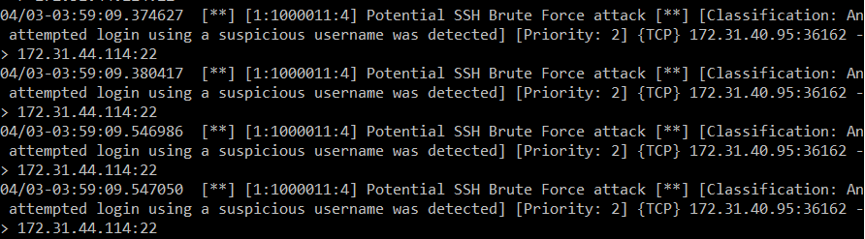
Features Identified:
Connection to server (Windows/Linux on AWS)
Destination port: 22
Threshold based detection: 3 attempts in 60s
SYN flag set
Alert generated on AWS instance:

Slide 9
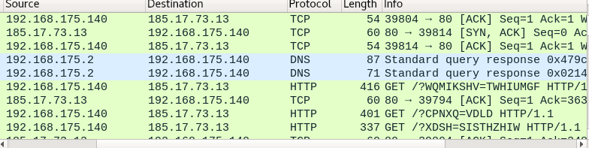
Denial of Service
DoS attacks are attempts to make an online service unavailable by overwhelming it with traffic.
HTTP Flood
Tools used: Hulk (HTTP Unbearable Load King) – used to attack web server by generating volumes of unique and obfuscated traffic.
Features:
Low threshold – 100 in 60s
Connection: to server
Payload content matching: GET/POST

Slide 10
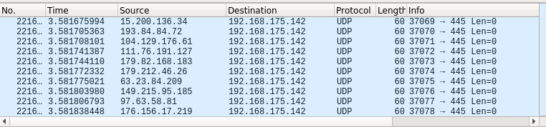
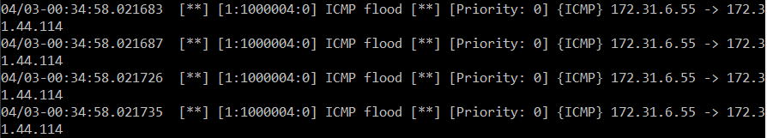
Tools used :
hping3 – network tool to make and send custom TCP/IP packets
Threshold based detection on specific ports
UDP flood:
ICMP flood
UDP ports: 53,67,68,445,88,138

Slide 11
Smurf attack: Large number of ICMP packets with the intended victim’s spoofed source IP are broadcast to the network.
Features:
Threshold based – 100 in 1s
ICMP echo Type 8
Tracking by src
Fraggle Attack: similar to smurf, however UDP traffic is used.
Features:
Threshold based – 1000 in 1s
Specific ports: 7,9,13,17
Tracking by src

Slide 12
Land flood – caused by sending a packet to a machine with the source host/port same as destination host/port.
Features:
Threshold – 100 in 1s
sameip feature – same source and destination IP
TCP packets with SYN flag set
Teardrop Attack: Sending mangled IP packets – over-sized and loaded with payloads. Various OS have a bug in their TCP/IP fragmentation reassembly code which leads to crash of OS.
Features:
Fragment flag set
Id: 242

Slide 13
ARP spoofing
This methodology is generally used by attackers for performing man-in-the-middle attacks by convincing the victim that the destination MAC address is associated with their IP address.
Snort has a rule to detect this in snort.conf:
preprocessor arpspoof
preprocessor arpspoof_detect_host: 192.168.0.8 00:09:5B:3B:CE:E6
There is very little automatic about this rule. However, since this is hardcoded, it can also detect ARP cache overwrite attacks.
We have implemented a better way to do this through OSQuery.

Slide 14
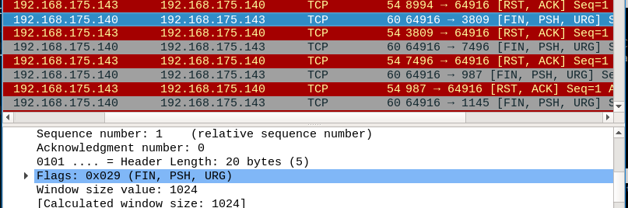
Stealth Port Scans
Tool used: Nmap- security scanner used to discover hosts and services on a network.
Xmas Scan – sends packets with varying destination ports to find out which ports are open and which are closed.
Features:
FIN, PSH,URG flags set (checking behavior to packets that it shouldn’t generally be getting)

Slide 15
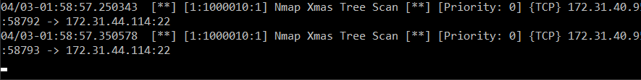
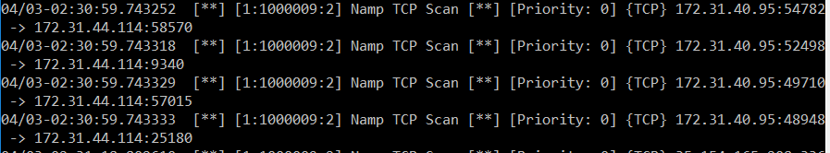
Port identification i.e. RST, ACK for closed ports and no response for open ports.
Similar analysis done for Ping (dsize =0) and TCP scans (flag A).

Slide 16
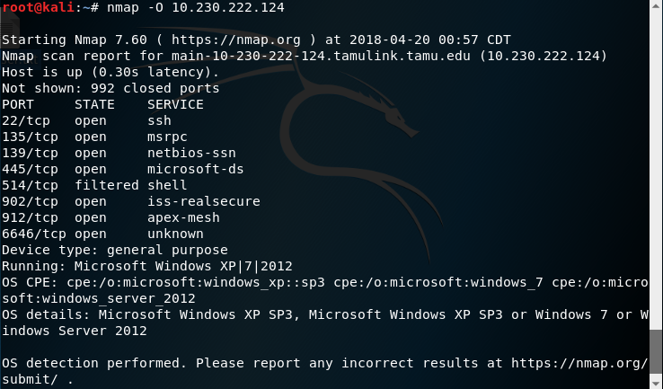
Nmap OS fingerprinting

Slide 17
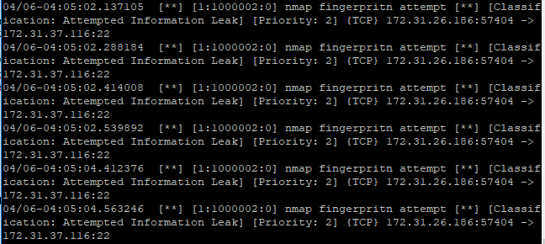
Identifying OS through SYN/ACK sent by open ports – checking the timestamp option. Different OS use different algorithms like linear extrapolation.
Features: FIN, SYN, PSH, URG flags

Slide 18
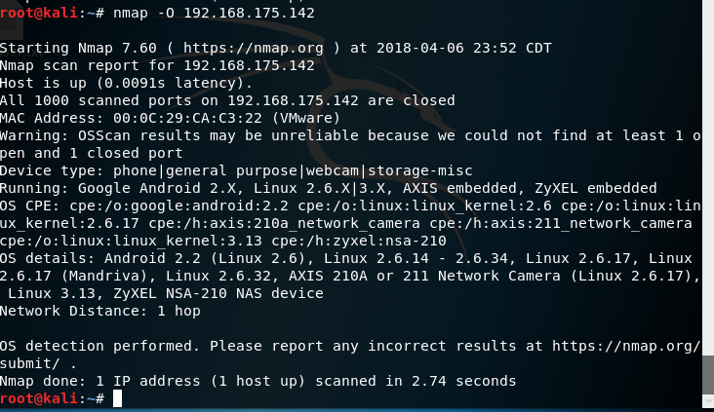
If all our ports are closed, it is not possible to detect the OS.

Slide 19
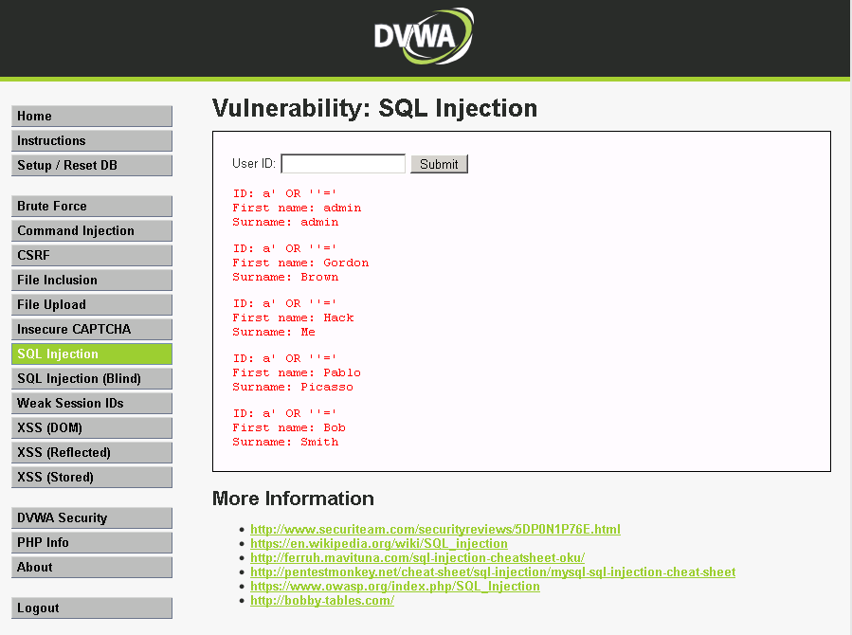
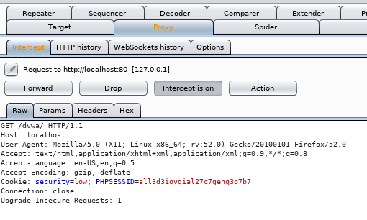
Web Based Attacks
SQL Injection: It refers to the technique of inserting SQL meta characters and commands into Web-based input fields in order to manipulate the execution of the back-end SQL queries. These are attacks directed primarily against another organization's Web server.
Tools used: DVWA, Burpsuite and sqlmap

Slide 20
Features discovered online:
(\%27)|(\') - the single-quote and its hex equivalent union - the keyword union
(\%6F)|o|(\%4F))((\%72)|r|(\%52) - the word 'or' with various combinations of Its upper and lower case hex equivalents.
Further keyword search: select, insert, update, delete etc

Slide 21
Cross Site Scripting Attacks: These attacks work by embedding script tags in URLs and enticing unsuspecting users to click on them, ensuring that the malicious Javascript gets executed on the victim's machine. These attacks leverage the trust between the user and the server and the fact that there is no input/output validation on the server to reject Javascript characters.
Features: </script> tags: normalized URI field, established connection to server
((\%3C)|<) - check for opening angle bracket or hex equivalent
((\%2F)|\/)* - the forward slash for a closing tag or its hex equivalent
[a-z0-9\%]+ - check for alphanumeric string inside the tag, or hex representation of these
((\%3E)|>) - check for closing angle bracket or hex equivalent

Slide 22
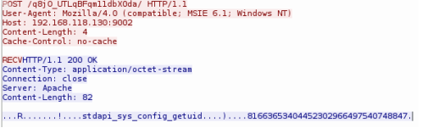
Metasploit
It is a computer security project that provides information about security vulnerabilities and aids in penetration testing and IDS signature development.
Earlier versions performed content/payload matching:
As seen from the pcap file: stdapi_sys_config_getuid, stdapi_sys_config_sysinfo, stdapi_sys_process_execute
Such matching is not possible anymore because of different encoding schemes that are being used like Base64, UTF-8,different XOR encoders.

Slide 23
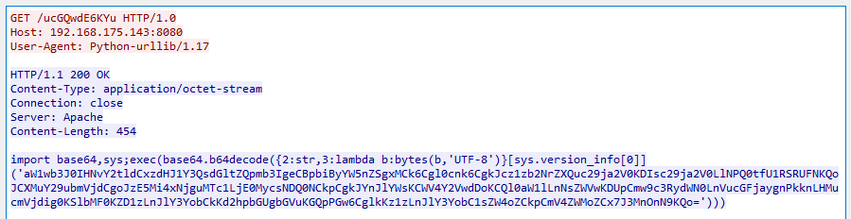
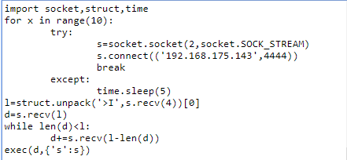
Base 64 decoded:
Content Type: octet stream – contains arbitrary binary data

Slide 24
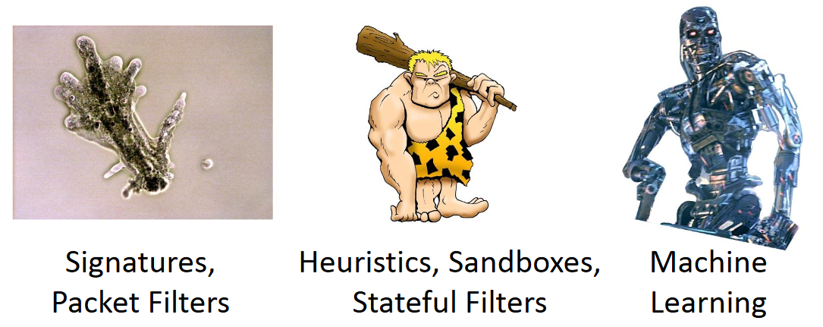
Moving On…

Slide 25
OSQuery
FOSS developed at Facebook, a part of IDS agent
Provides information about “concepts”, abstracting OS as a database.
Can operate in a daemon mode too.
osqueryi
osqueryd
A cross platform agent
Allows scheduling of the queries and collects events in a log.

Slide 26
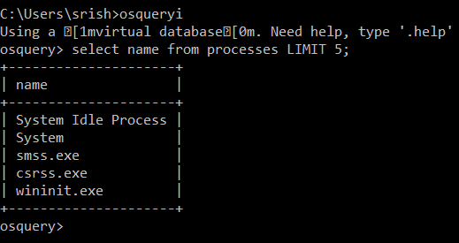
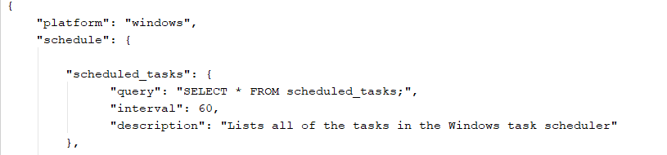
Examples - OSQUERY
osqueryi : A CLI Shell
osqueryd : A daemon system

Slide 27
Machine Learning with OSquery
We have tried to train a unsupervised model per machine, using general user activities like browsing, iterating directories, shell activity etc.
Use Anomaly Detection Approach to predict anomalous points in the system.
These activities can be used to develop new IOCs for the machines, update our rules in snort, alerting and logging.

Slide 28
What is Anomaly Detection?
Point Based Anomaly: If an individual data point in a stream of data is anomalous, then it is a point based anomaly. Bank Based Fraud Detection system.
Contextual Anomaly: See context rather than a point in data. Credit card fraud detection system using transactions.
Collective Anomaly: If a collection of data is anomalous with respect to entire data we term it as a collective anomaly. Example of a logging system trace: ..http-web, buffer-overflow, http-web, http-web, smtp-mail, ftp, http-web, ssh, smtp-mail, http-web, ssh, buffer-overflow , ftp, http-web, ftp, smtp-mail,http-web

Slide 29
Challenge
Unlabeled Data
???
Anomalous Points
We have some unlabeled data from the user’s machines
A model to classify “inliers” and “outliers” [OCSVM (One Class Support Vector Machines)]
After training, model should predict the anomalous behavior on testing data.
All the data is generated through osquery daemon using scheduled queries.

Slide 30
Features..
More than 50 tables provided by osquery to create intelligent queries.
Concept Captured:
Scheduled tasks
Services installed
Etc_hosts
Shared_resouces
Wmi consumers
Logged_in_users
Open_ports
Arp cache
Persistance artifacts for commonly known Trojan like ccleaner.floxif
System processes like conhost, svchost (self and parent process), lsass, dllhost, paths. A check to identify any disguise activity.
ARP Spoofing:
SELECT * FROM ( SELECT COUNT(1) AS mac_count, mac FROM arp_cache GROUP BY mac ) WHERE mac_count > 1;

Slide 31
Demo
Video :
https://drive.google.com/file/d/1y-Bizqe4zh-dquIKWclb6ySecuJm74E1/view?usp=sharing
Analysis:
https://drive.google.com/open?id=1Hocog1_ho3Bqfl1gGDmszPXOsQFUp69u

Slide 32
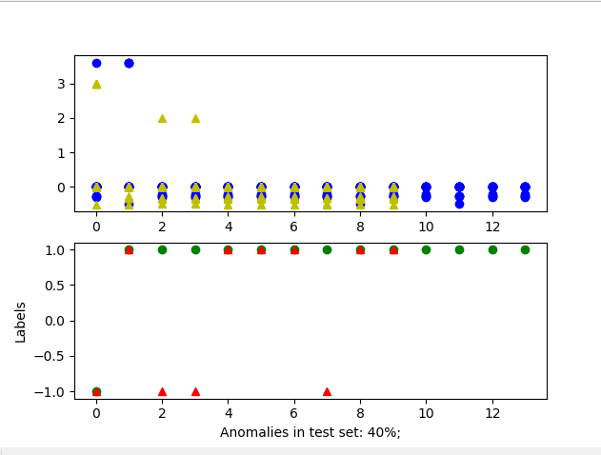
Evaluation
Dataset:
Training dataset from windows machine in cloud capturing some common user activities.
Testing dataset obtained by capturing the events from similar activity in demo.
Results:
The adjoining figure projects the
test data and train data on the
same plane
Our classifier predicts the
anomalies on the testing data

Slide 33
Future
Evaluate snort on web based attacks on cloud.
Progress: Have extracted the features on local machine
Develop queries to reduce false positives
Progress: Currently covering simple queries for different concepts

Slide 34
Questions?
Thanks

